Slide 1
How to cut fat and bloat from your app?
Mohammad Faani
@mfaani
Notes:
Karen and Ashley two of my team members started working on…

Slide 2
Journey
xcodebuild archive -workspace "Example/Video.xcworkspace" -scheme "Video" -destination "generic/platform=iOS Simulator" -configuration Release
only_active_arch=no
-archivePath "build/iOS-Sim"
SKIP_INSTALL=NO
BUILD_LIBRARY_FOR_DISTRIBUTION=YES
OTHER_SWIFT_FLAGS="-Xfrontend -module-interface-preserve-types-as-written"
Notes:
Context: I was tasked to figure out why using XCFrameworks causes an increase in our app size. But I didn’t know anything about XCFramework, what it meant something is compiled. I didn’t understand these flags being passed. I didn’t know where/how in what phase the compilation happens. I had a lot of questions….

Slide 3

Me
Notes:
So many unanswered questions….

Slide 4
Agenda
Jargon and Anatomy
Binary creation
swiftc demo
Build Directory Inspection
How to inspect binaries
Symbols
X-Rays and Surgeries
nm, strip, otool demo

Slide 5
How do you create a binary?

Slide 6
What’s a binary?
You’re already using them every day
They don’t have a file extension
They’re created as the end product of linking everything together.
Things you link:
Your own source files
Dependencies (source file or pre-compiled)
Notes:
First let’s find out what’s a binary

Slide 7
Super High Level
Source Code
Compiler
Object Code
Linker
Product

Slide 8

What’s an object file?
In binary format
Might reference undefined symbols
Useless by itself
Notes:
Much like a piece of a puzzle
It’s named object code, because its your objective code. As opposed to subject code (your source code)
Any external your file you’ve linked to, will appear as undefined in the object file

Slide 9
Super High Level
Source Code
Compiler
Object Code
Linker
Product
Machine code (binary)
Notes:
They’re both puzzle. Only that one is a puzzle piece. The other is a complete stitched together puzzle

Slide 10
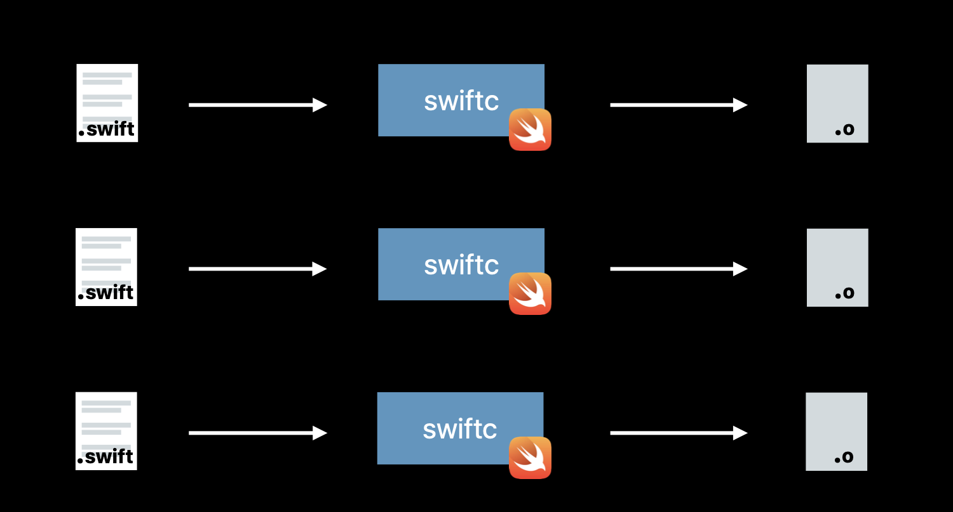
Each file gets compiled

Slide 11
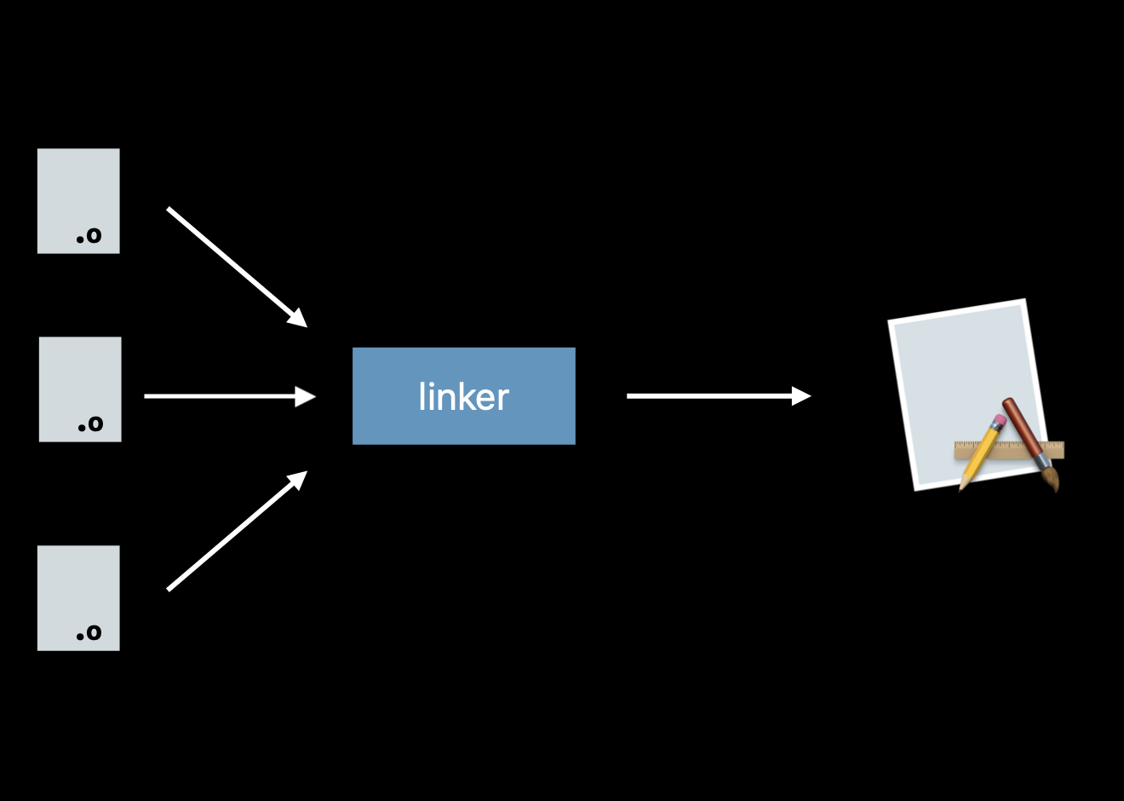
Any needed object files get linked into the binary

Slide 12
Demo compiling a Swift file

Slide 13
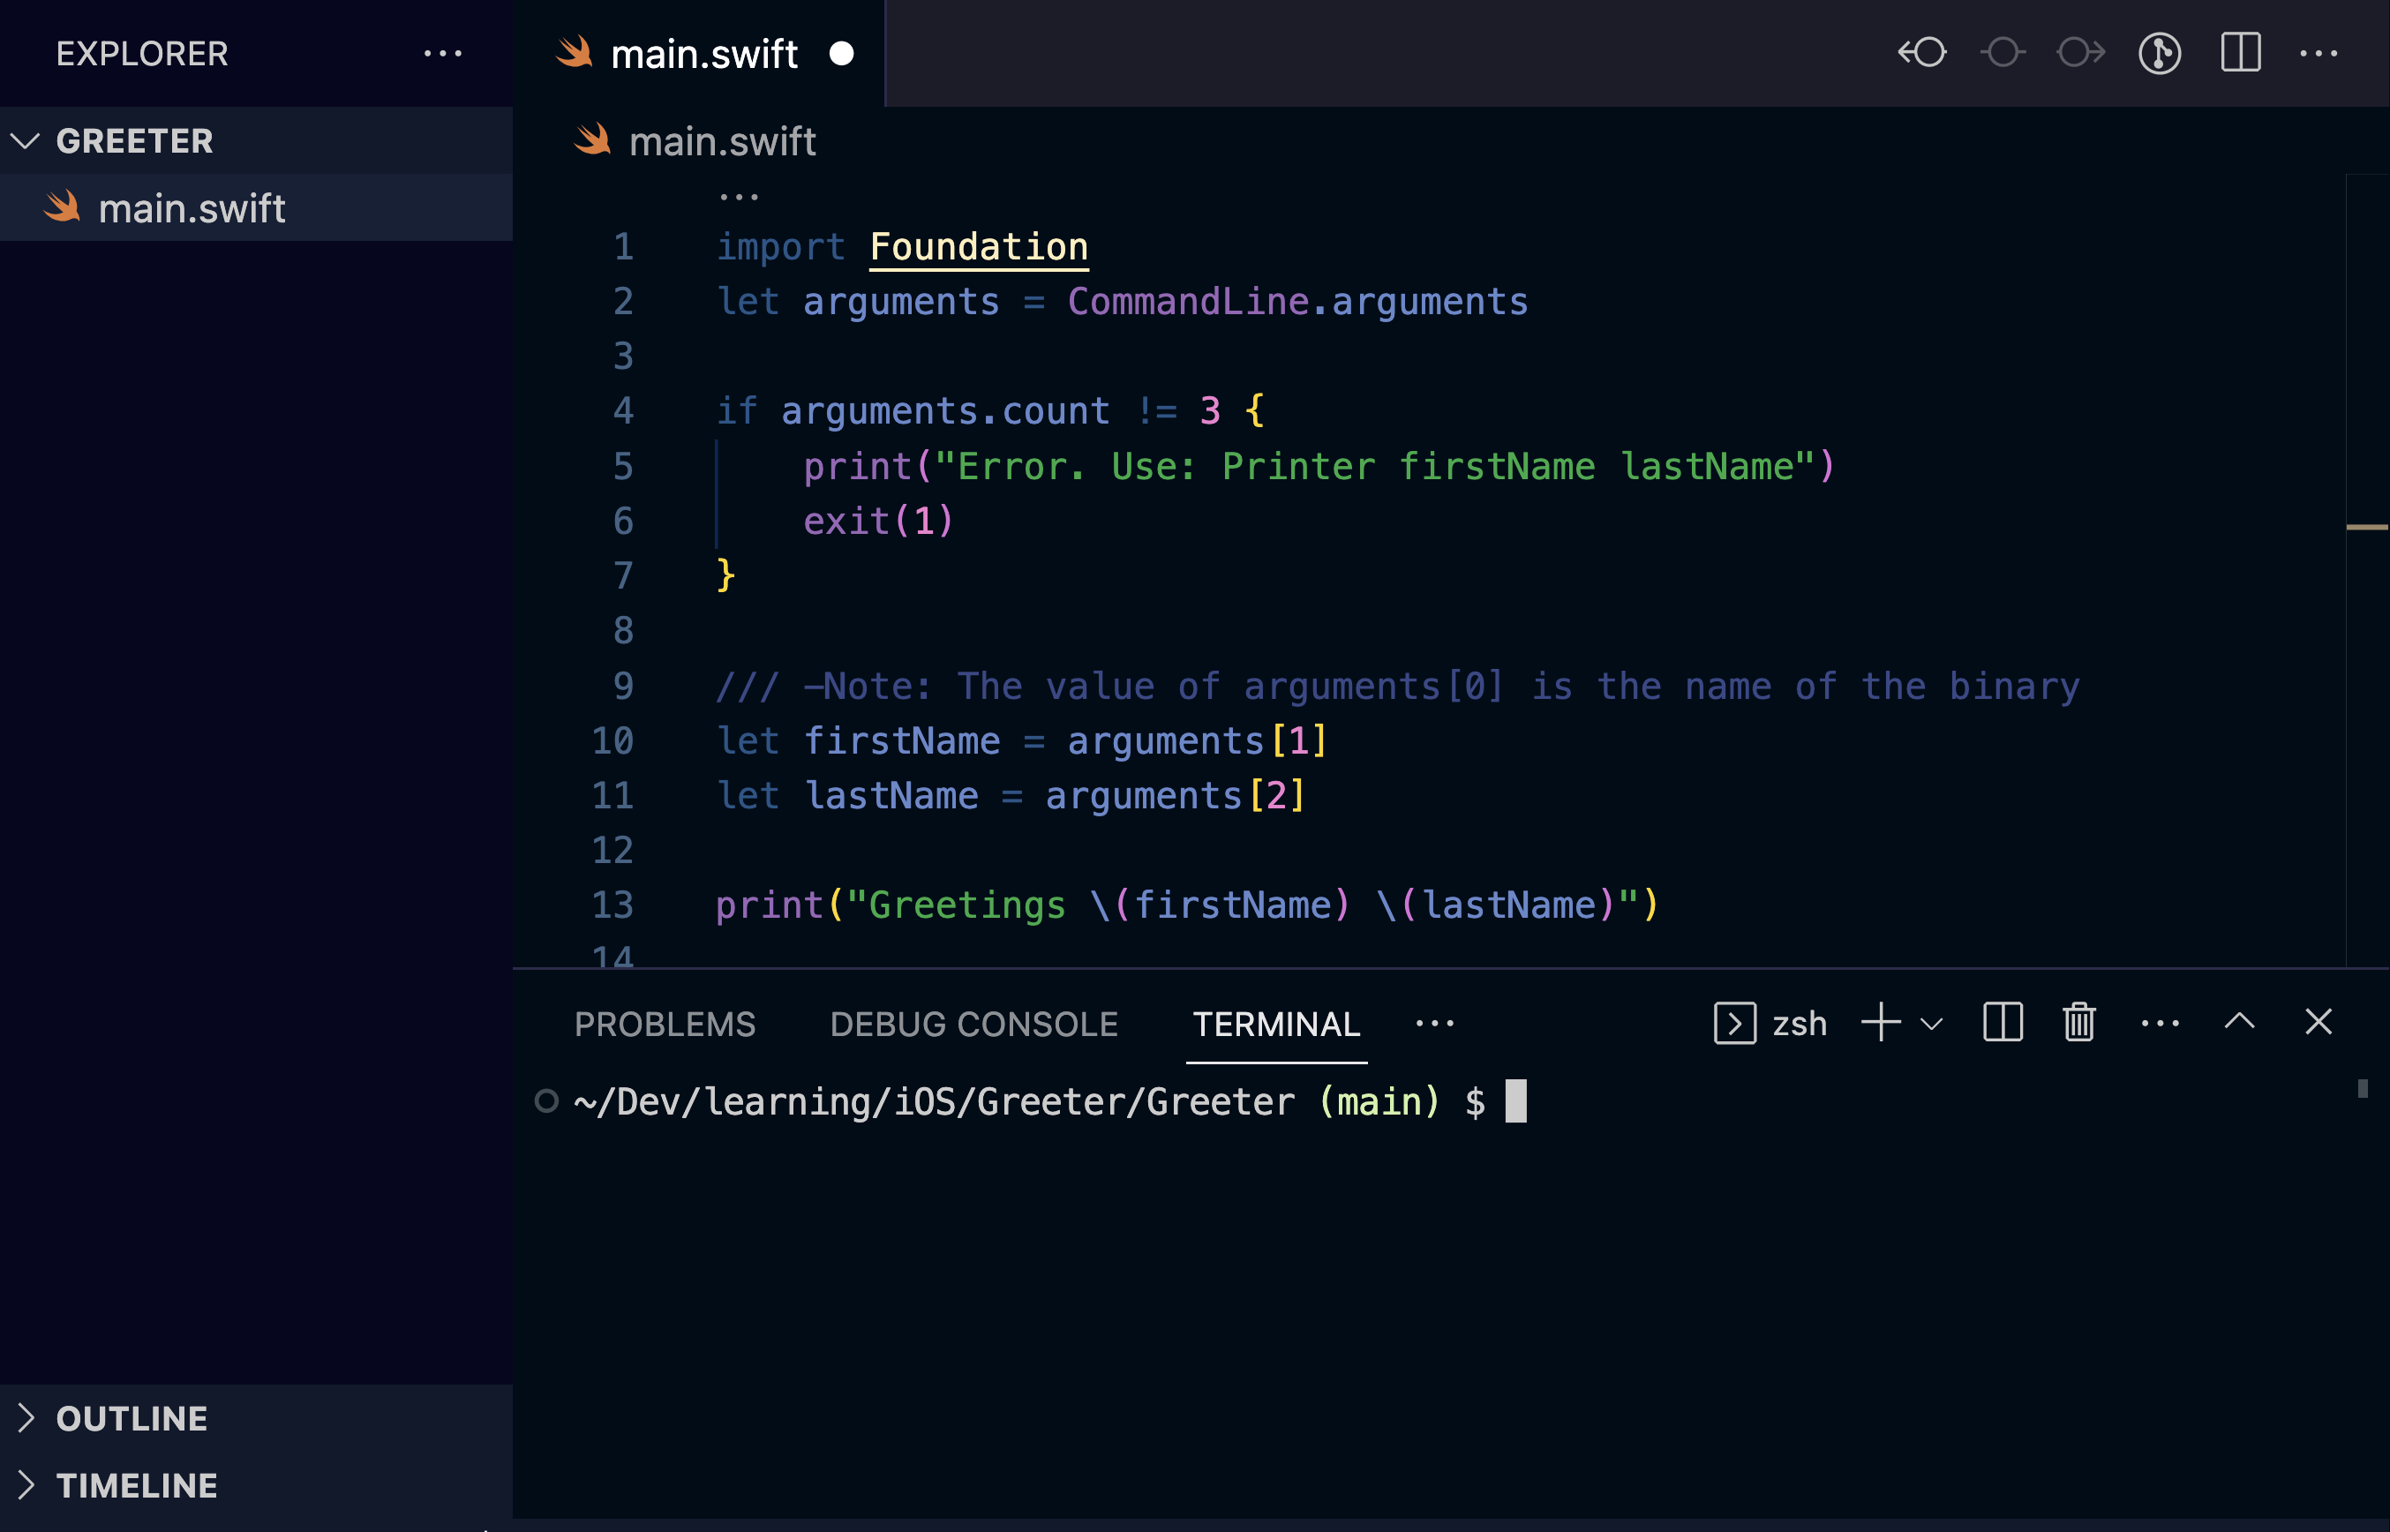

Slide 14
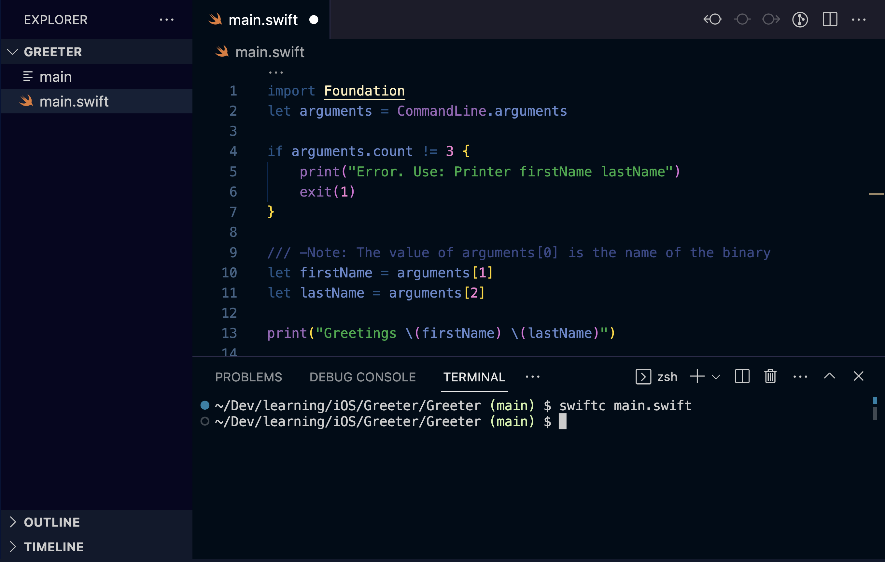

Slide 15
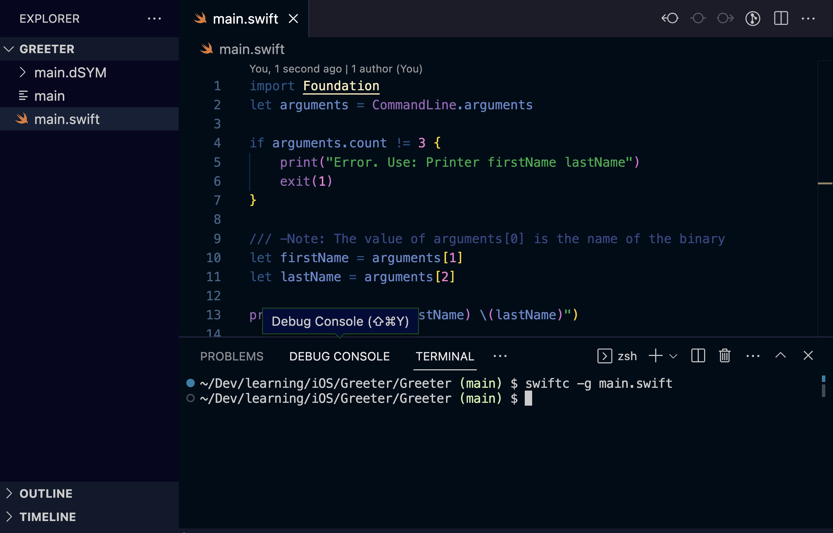

Slide 16
Passing -v to swiftc
/Applications/Xcode13.3.1.app/Contents/Developer/Toolchains/XcodeDefault.xctoolchain/usr/bin/swift-frontend -frontend -c -primary-file main.swift -target arm64-apple-macosx12.0 -Xllvm -aarch64-use-tbi -enable-objc-interop -stack-check -sdk /Applications/Xcode13.3.1.app/Contents/Developer/Platforms/MacOSX.platform/Developer/SDKs/MacOSX12.3.sdk -color-diagnostics -new-driver-path /Applications/Xcode13.3.1.app/Contents/Developer/Toolchains/XcodeDefault.xctoolchain/usr/bin/swift-driver -resource-dir /Applications/Xcode13.3.1.app/Contents/Developer/Toolchains/XcodeDefault.xctoolchain/usr/lib/swift -module-name main -target-sdk-version 12.3 -o /var/folders/gp/q_3k63zj46g24mq0t2tz_s640000gp/T/TemporaryDirectory.NyRccE/main-1.o
/Applications/Xcode13.3.1.app/Contents/Developer/Toolchains/XcodeDefault.xctoolchain/usr/bin/ld /var/folders/gp/q_3k63zj46g24mq0t2tz_s640000gp/T/TemporaryDirectory.NyRccE/main-1.o /Applications/Xcode13.3.1.app/Contents/Developer/Toolchains/XcodeDefault.xctoolchain/usr/lib/swift/clang/lib/darwin/libclang_rt.osx.a -syslibroot /Applications/Xcode13.3.1.app/Contents/Developer/Platforms/MacOSX.platform/Developer/SDKs/MacOSX12.3.sdk -lobjc -lSystem -arch arm64 -L /Applications/Xcode13.3.1.app/Contents/Developer/Toolchains/XcodeDefault.xctoolchain/usr/lib/swift/macosx -L /Applications/Xcode13.3.1.app/Contents/Developer/Platforms/MacOSX.platform/Developer/SDKs/MacOSX12.3.sdk/usr/lib/swift -platform_version macos 12.0.0 12.3.0 -o main

Slide 17
Where it gets blurry
Build/Products
core.framework
auth.a
cool.app
cool (binary)
/Frameworks
core.framework
core (binary)
assets
provisioning profile
storyboards
info.plist
assets
Notes:
It’s a two step process.
build all dependency targets. Your app’s main binary is just another dependency. But it’s probably the last dependency that gets built.
Extract everything needed from the build directory into the app’s bundle…
Unlike dynamically linked frameworks, Static libraries are indistinguishable from app’s main binary.

Slide 18
Build process
Dependency Graph
Compile
Link
Copy files
Create app bundle
Stripping
signing
Create dSYM

Slide 19

Inspection

Slide 20
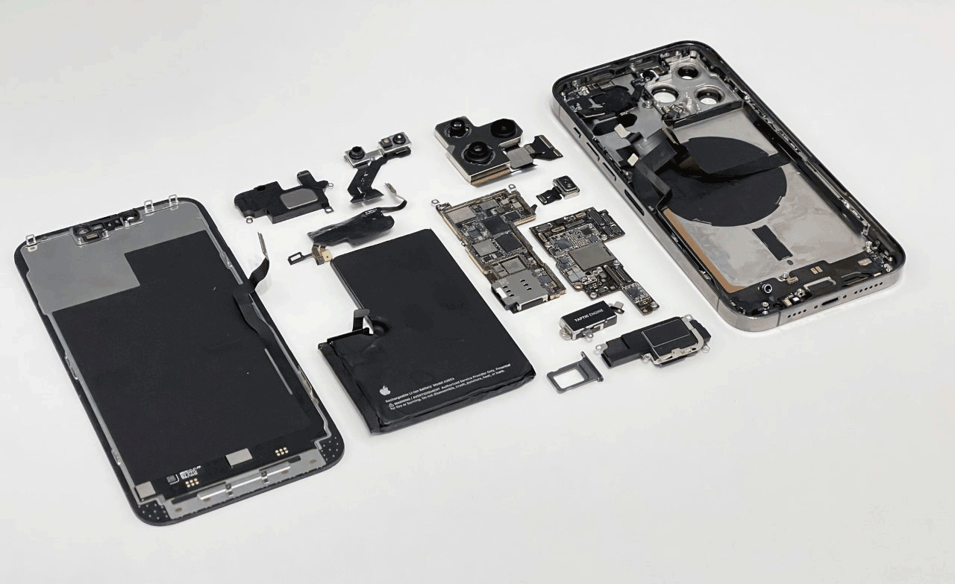
Ways of inspecting?
Sample apps with using `swiftc` and passing in `-v`
Build logs
Inspecting binaries
Get Physical
Notes:
You can also unscrew your iPhone and look into the resistors with a microscope to inspect each binary. That doesn’t work though…

Slide 21
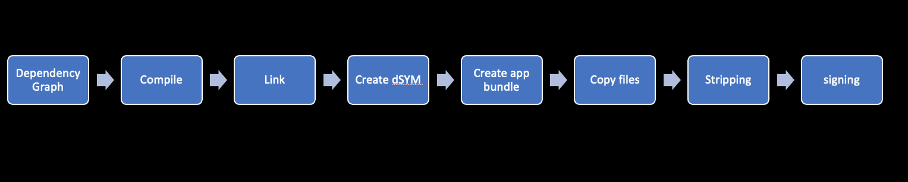
Commands you want to look for
swift-frontend
ld
dsymutil
strip

Slide 22
Static vs dynamic – symbol lookups
otool for external dependencies of your binary
nm for symbols within your binary

Slide 23
Symbols

Slide 24
Types of symbols
Global
Debug
Local
Undefined symbols (your dependency)
etc

Slide 25
Demo nm, strip, otool
See all symbols of a binary
Strip swift and debug symbols of a binary
See all symbols of a binary after stripping them
See external dependencies linked at runtime/launch time (as opposed to thinks already linked during build)
nm –a main | wc –l
strip –ST main
nm –a main | wc –l
otool -L main

Slide 26
Which Build Settings Matters?
Main app Build Settings
Pods Project Build Settings
Podfile
Pod Repo Build Settings

Slide 27
CocoaPods
https://github.com/CocoaPods/CocoaPods/issues/10277

Slide 28
Why saving space matters?
“I have customers who can’t open their sqlite database because they only have 20mb free. They will be delighted. sqlite tries to memory map some file, and that will fail if you are at 1GB or less – Russ Shanahan (Happy scale)”

Slide 29
Recap
Build = Compiling each file with swiftc, then linking them all together using ld
Don’t substitute command line tools easily
Apple has an abundance of good resources scattered
Validate your build stripping settings
Inspect binaries using nm & otool and other tools (dsymutil, clang, ld, dwarfdump, strip)
Notes:
Building an x-ray vision for yourself helps to find ways to improve, correct your build process.

Slide 30
References
Link fast: Improve build and launch times
Behind the Scenes of the Xcode Build Process
Compiling and Linking (Alex Allain)
Sub-modules for Xcode
Reducing your app’s size
Demystify parallelization in Xcode builds
Building Faster in Xcode
Symbolication: Beyond the basics

Slide 31
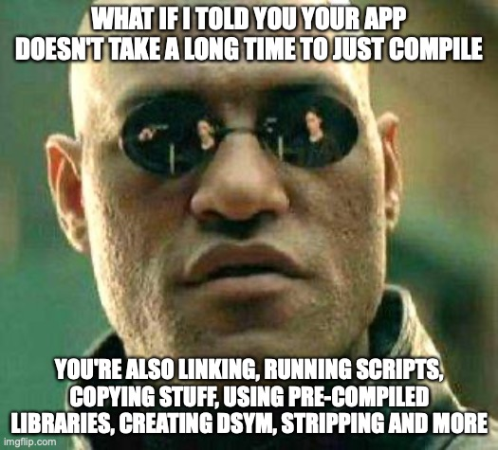
Key take away Thank you
@mfaani (Twitter, GitHub, Stackoverflow)
mfaani.com

